Slide 1
Leveraging object oriented programming (OOP) in Python for bioinformatics
a skills seminar by:
Carmelle Catamura
2.14.2024

Slide 2
What is OOP?
Object oriented programming (OOP) is a method of structuring your program so that data and functions that work together are organized into a single unit called an object.

Slide 3
What are the benefits to OOP?
better code organization
easier code maintenance
enforces modularity and reusability when writing code
benefits of design - you can get really creative when solving problems

Slide 4
What are the downsides to OOP?
sometimes, OOP is not the answer!
“Simple is better than complex”
“Practicality beats purity”

Slide 5
What is a class?
a class is like a blueprint for creating a certain object.

Slide 6
What is a class?
What is an object?
a class is like a blueprint for creating a certain object.
an instance of a class

Slide 7
What is a class?
What is an object?
a class is like a blueprint for creating a certain object.
What is a method?
a method is a function
belonging to the class
an instance of a class

Slide 8
What is a class?
What is an object?
a class is like a blueprint for creating a certain object.
What is a method?
What is an attribute?
a method is a function
belonging to the class
an instance of a class
a data element or a property of an object

Slide 9
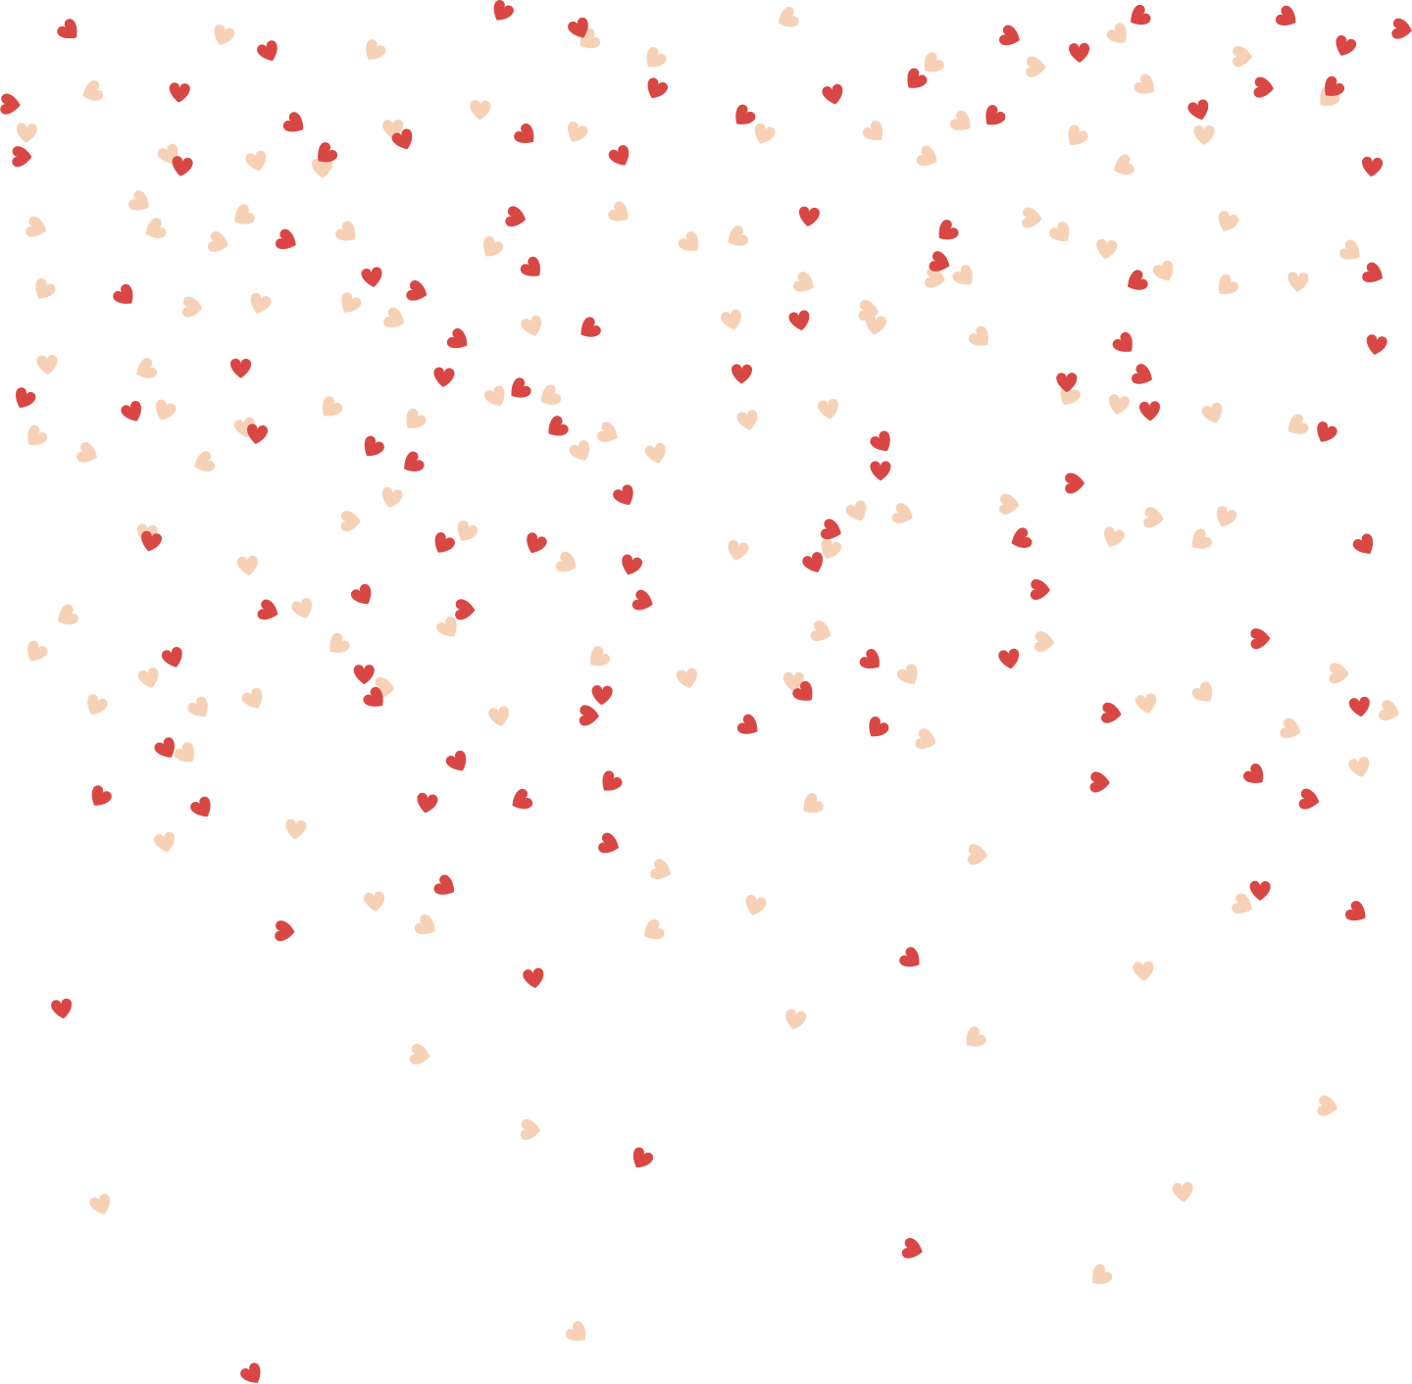
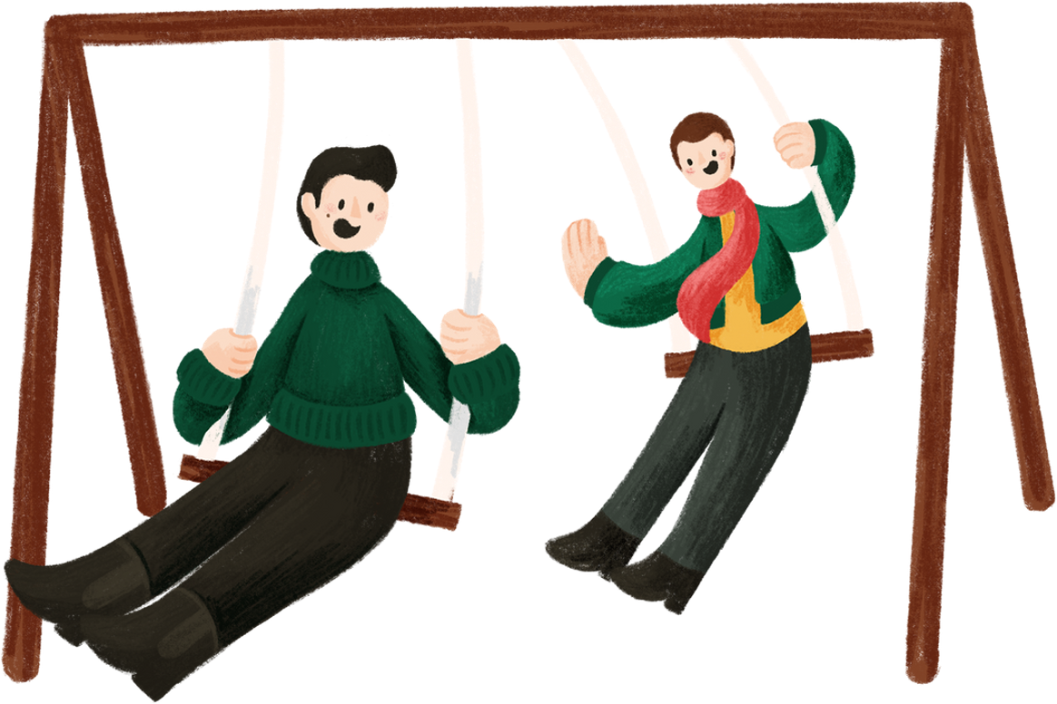
__init__()
every class needs this! initializes an object of a class; a constructor
self
represents an instance of the class; the first parameter to all the methods in a class; by using self we can access attributes and methods belonging to an object.

Slide 10
Let’s try it! Follow along using a text editor or a python IDE :)
Create a class called “Dog”

Slide 11
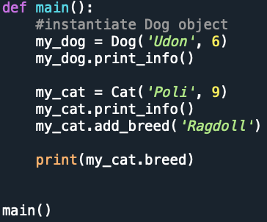
Accessing functions and properties of a class
you can access properties and attributes of a class using . (‘dot’)

Slide 12
Class inheritance
a class can inherit all attributes and methods from another class

Slide 13
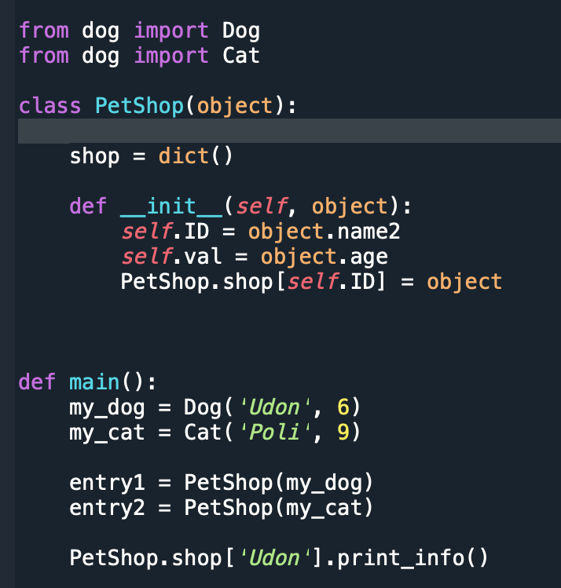
You can easily import your class to another script!
(What is Abstraction!?)

Slide 14
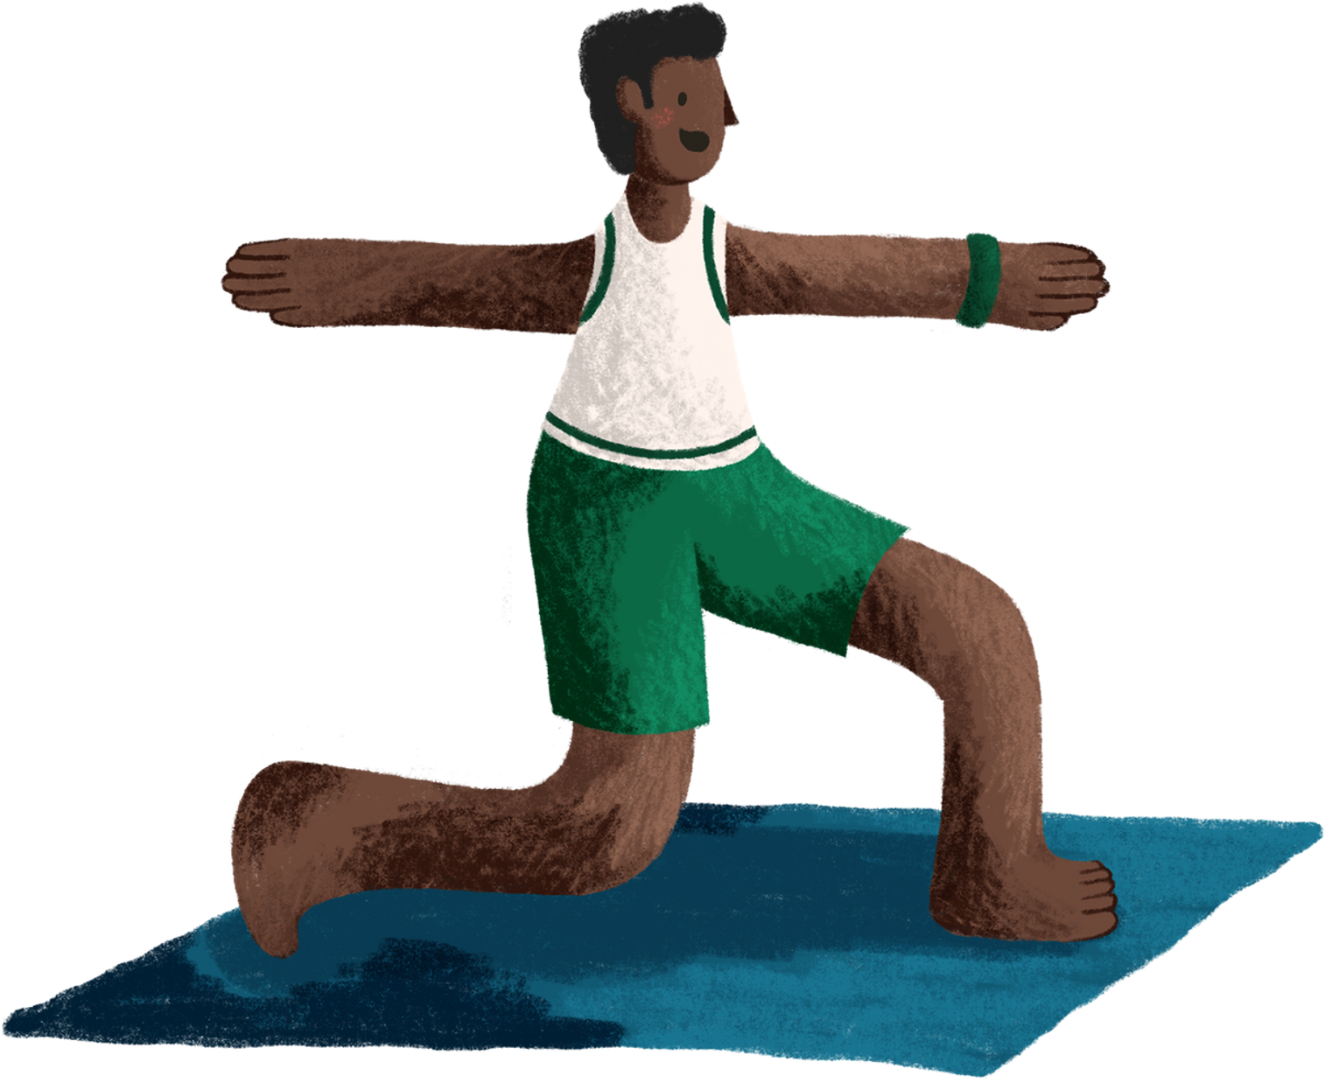
Everything in python is an object! Lots of cool Python libraries are written OOP style

Slide 15
Everything in python is an object! Lots of cool Python libraries are written OOP style

Slide 16
How I use OOP in my research IRL

Slide 17
Thank you!
if you would like a copy of the slides/scripts email me at carmelle@berkeley.edu

